Slide 1
Future Professional Task Group 10 – Service
Emily Lipscombe, Ruth Goldacre, Alex Taylor, Claire Woodward, Festus Agbongiasede & Andy ridgway
Partner Sponsor – Steven Reynolds
March 2023

Slide 2
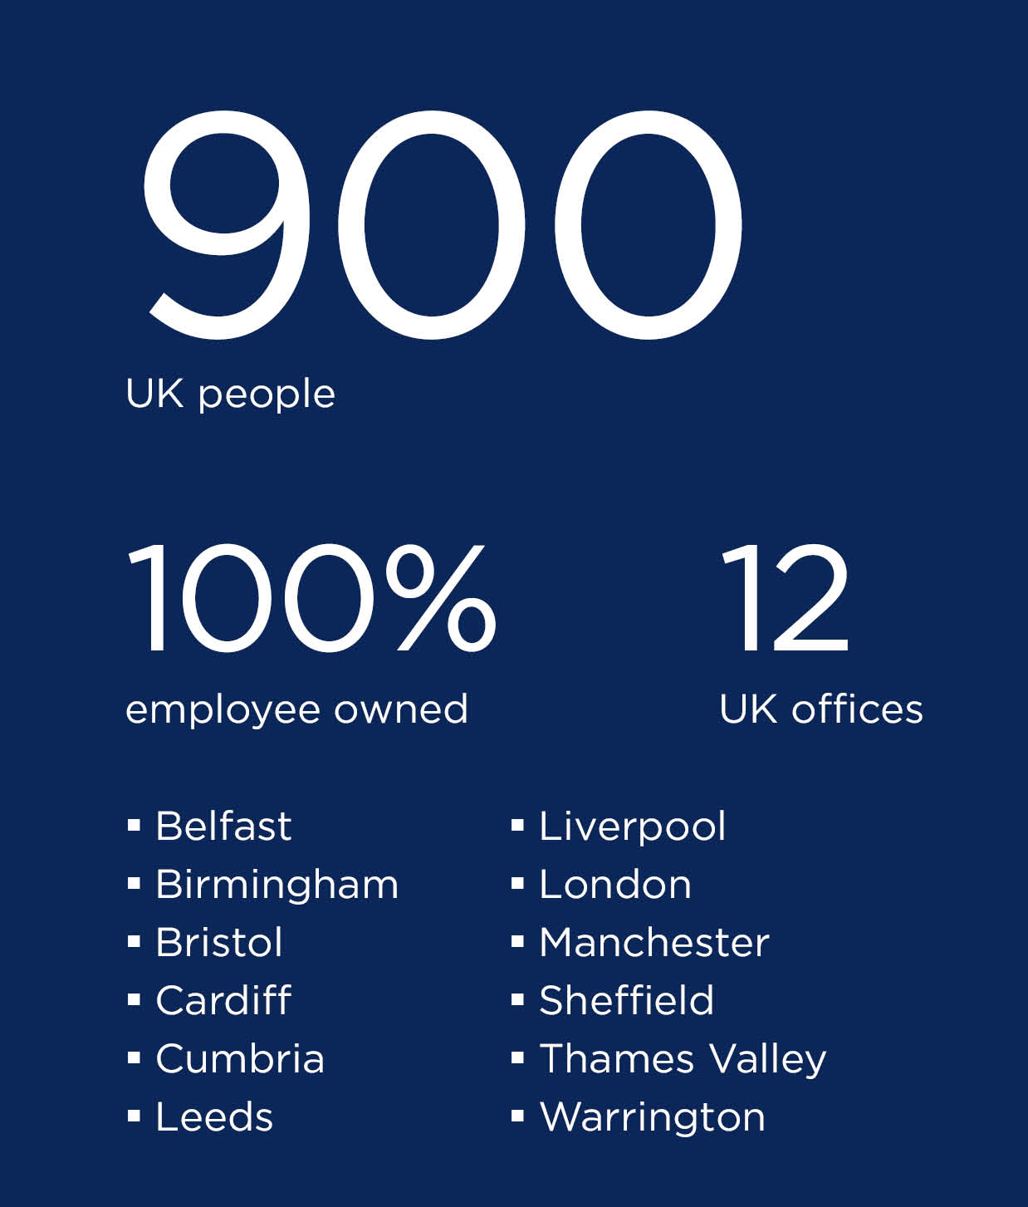

UK
Our Team
Notes:
Discuss where UK offices are located and the spread of the presenting team

Slide 3
Improving Inter-office Relations Through our Services
Step 2 Integrating Services
Step 3 Holistic Bids
Step 1 Knowledge Sharing
Notes:
Explain the concept
Essentially a process to achieve ‘improved inter office relations’ thus improving ‘Service’
Step 1 knowledge sharing
Step 2 integrating services
Step 3 holistic bids

Slide 4

Step 1 - Knowledge Sharing
Step 1 - Knowledge Sharing
Notes:
Cross-Office Knowledge Sharing – Alex Taylor
CPD Delivery – Claire Woodward

Slide 5
Cross office Knowledge Sharing
PREVIOUS EXAMPLES
FP2 Presentation Skills
Future Professional Conference
Global Conference
BENEFITS
Expanding internal network
Potential to assist holistic bids and integrate services
Potential to tie into CPD delivery
Step 1 - Knowledge Sharing
Notes:
AT to present.
Previous Examples
FP2 Presentation Skills –
I attend this myself at the Manchester Office along with several other Future Professionals from offices such as Liverpool, Manchester, and Birmingham.
Future Professional Conference –
This being the origin of today presentation, and was held in Birmingham.
Global Conference
Emily attended a few meetings assisting with the organisation for the global conference. This was held in the London Office, with a variety of internal RLB staff.
Benefits
Expanding internal network
Within each competency, and also external / across all competency’s
Allowing an increase of shared knowledge
As future professionals (especially, but also any professional) there is always someone with a more advanced knowledge on a particular area.
Potential to assist providing holistic bids and integrated service.
If we already have an existing relationship with people across all sectors, working together to provide these services will in theory run smoother.
Potential to tie into CPD delivery.
Attended different offices where applicable.

Slide 6
Individual office CPD sessions
Cancelled Sessions
cpd Delivery
How it works now
Inconsistency of how sessions are promoted
Step 1 - Knowledge Sharing
Notes:
Each office delivers their own CPD sessions which are promoted to other members of that office
Those progressing a professional qualification have to find external resource to meet the required CPD hours and these often don't go ahead due to external resource issues.
Employees aren't aware of the wealth of CPD on offer across the offices

Slide 7
CPD Delivery
WE PROPOSE
Central location on Connect
Promoted via the ‘RLB Round Up’
BENEFITS
Increased access to more CPD
Live and archived sessions
Improves cross-office relationships
Step 1 - Knowledge Sharing
Notes:
CW to present.
Central location on Connect for CPD
Offices add notices for upcoming CPD
This could be categorised into
Online or in-person
Each discipline
Employees notified of any CPD coming up in next week/month in the RLB Round Up email, directing them to Connect where they can add themselves to attendee list
All sessions where possible are recorded and added to online archive
BENEFITS
Employees will have access to more CPD that is relevant to their role
Increased opportunity to upskill
Keeps those pursuing professional qualifications on track
Employees will have contact will staff from other offices, improving cross-office relationships
Employees can access the archive of videos in their own time, so do not miss out due to meeting / commitment clashes.

Slide 8
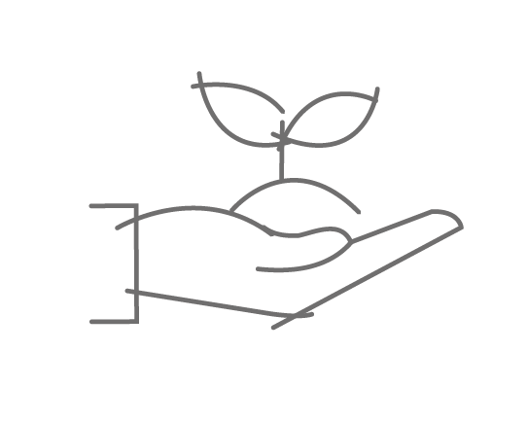
Step 2 - Integrating Services
Step 2 – Integrating Services
Notes:
Integrating Services – Emily Ward
What services need to be expanded upon? What more can RLB offer?
How can we incorporate other services in our day to day roles?
Who do RLB want to work with, where is the industry going?
What are RLB doing? What can we offer to our clients that we don’t already?

Slide 9
What can we integrate?
Every service we offer as a business can be integrated in someway, we’re already doing this in areas without knowing.
Our Focus
SUSTAINABILITY
Step 2 – Integrating Services
Notes:
Sustainability is the main area in which we feel can be dramatically improved due to its significant importance in today’s society as it is a global issue.
Not only RLB but companies, organisations and individuals around the world are focusing more on before suitable, reducing climate change and looking to protect our plat.

Slide 10
What is RLB UK doing to integrate sustainability?
Local Level (Integrating ESG)
Site Waste Management Plans (SWMP)
KPI improvement
Specify furniture, equipment etc recycling centres (Reyooz)
Look to decarbonise existing assets
Review cost plans
Nationally/Globally
‘Sustainability Consultancy’ service offering
RLB ‘Global Carbon Policy’
RLB ‘Global Carbon & Sustainability Committee’
Aiming to influence change across the market
Integrating sustainability – the impact on projects and clients
Step 2 – Integrating Services
Notes:
Feedback has shown an increasing number of Architects & Engineers are beginning to refuse working with clients who are not Net 0 or working towards a Net 0 target.
RLB offer a ‘Sustainability Consultancy’ service for client led by Heather Evans.
Through the use of sustainability RLB are aiming to influence change across the market leading with clients who haven’t yet started or are early on with their sustainability journey.
RLB have created a ‘Global Carbon & Sustainability Committee’ which includes members from RLB internationally
Offices need to be aware of what integrating sustainability would mean to their projects and clients
Assess the options on a project, what would the use of a more sustainable option mean for the client. Could it increase their KPIs and assist them in achieving their Net Zero emissions target

Slide 11
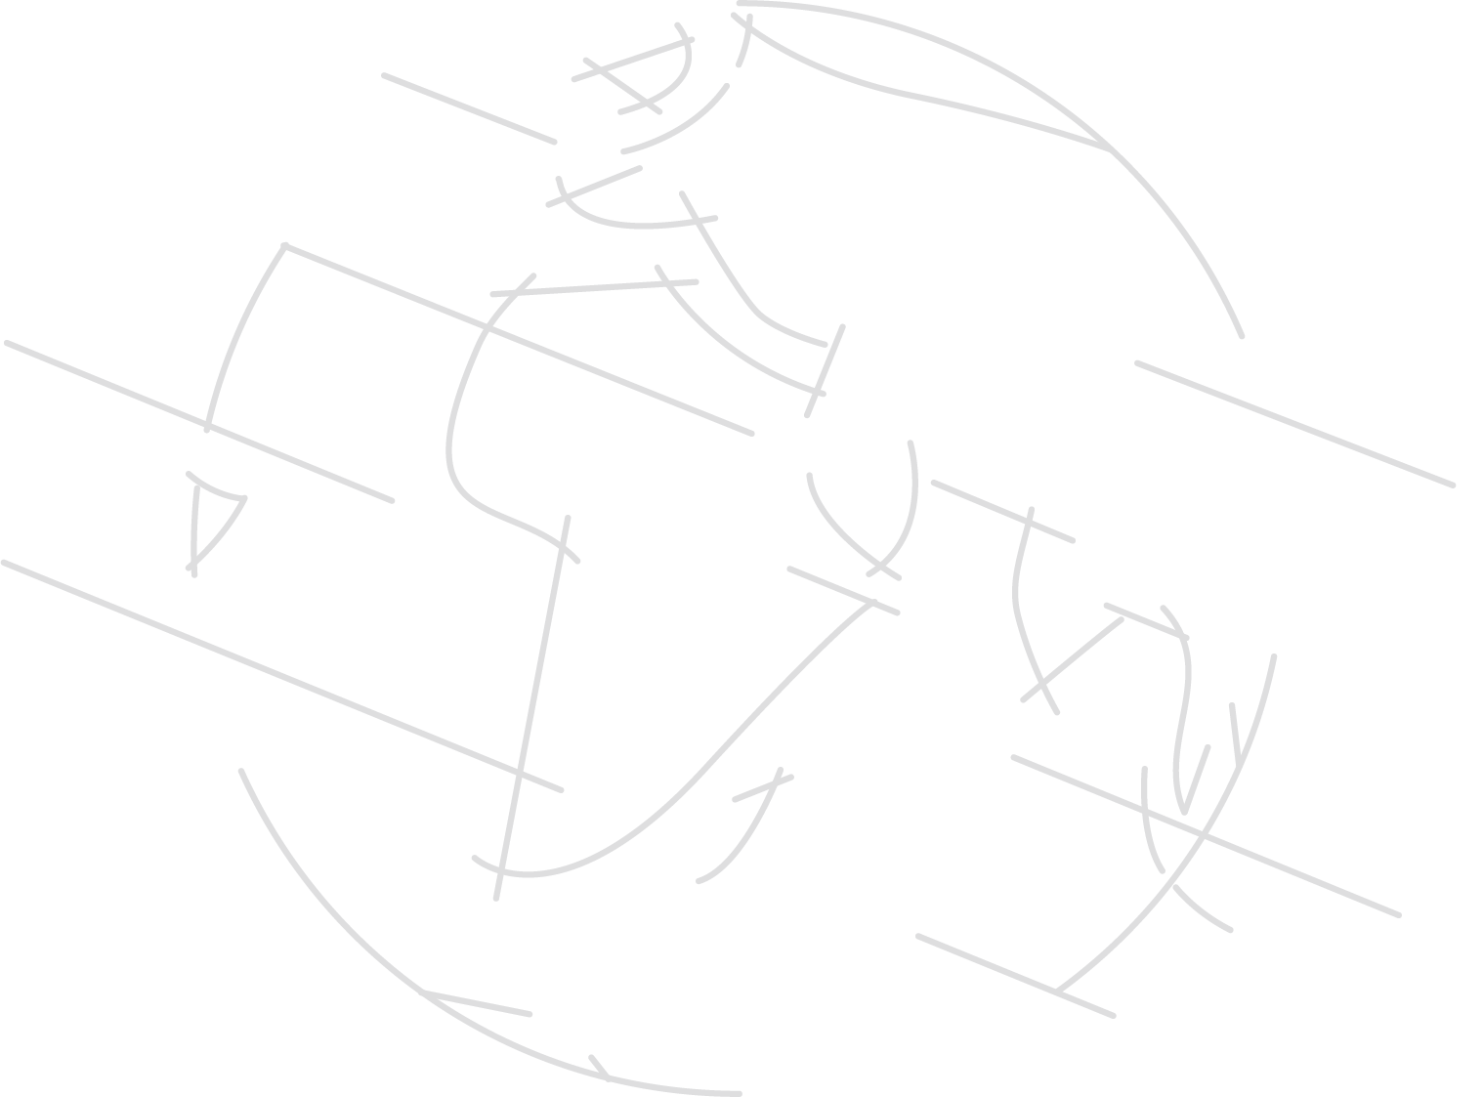
2030
Notes:
RLB Global Carbon Policy – Global target of net zero emissions by 2030
The Board has set a clear long-term goal to achieve net zero emissions by 2030 as a global business.
2030 – business plan

Slide 12

Step 3 - Holistic Bids
Step 3 – Holistic Bids
Notes:
Holistic Bids – Ruth Goldacre

Slide 13
Specialist Recruitment
Specialist Recruitment
Skills Gap
VS.
Reducing the need for free-lancers and sub-consultants will both reduce the overall cost for client, and increase RLB’s profit margins
Notes:
Notes:
If we have the provisions in place for holistic bids, why might progress have been stagnant?
Do the demands reflect the following?
Skills Gap
Identify areas where we have had to turn down or lost work due to lack of expertise, e.g. skills include interior architecture but not architecture
Identify areas where we rely on sub-consultants the most, e.g. SBEM surveys, structural/civil, complex M&E for labs
VS
Specialist recruitment
Identify emerging and/or growing industries and initiatives, E.g. Retrofitting (can retrain existing staff to be coordinators, but demand may require individuals to devote most of their time to it)
Identify technological advancements and how we could tap in, such as building on ChatGPT and AI to make it more reliable/credible.

Slide 14

Holistic bids: a new approach
Case Study: Mitie Framework
Step 3 – Holistic Bids
Notes:
Circling back, if we have acknowledged the skills gap/specialist recruitment, is it time for a new approach?
Mitie is one of the largest work streams for BS/PD/LD, we are often instructed off a framework and do the work on behalf of them. Assuming our liabilities are back to back with Mities framework, what if we cut out the middle man and took the instruction straight from the client?
We already have the connections and are frequently requested, and meet much of the pre-qualification criteria such as quality management under ISO9001 to deliver.
Like Field, it could also generate an internal drive for developing new processes/systems, which can then be sold and monetised.
Holistic bids involve 2 or more RLB services
Generally PM/QS, or BS/H&S/Design; rarely other combinations.
Versatility will assist in retaining clients, securing new ones and maintaining consistent work streams.
Teams, O365 and other pandemic-era technology will enable inter-office bids without much further investment.
Additional recruitment for specialist to limit sub-consultants and free lancers

Slide 15
Summary and next Steps
Step 1 – Short Term
Spotlight on Sector/Service
Step 2 – Medium Term
RLB Sustainability Best Practice Guidance Note
Step 3 – Long Term
Holistic Bids
TAKEAWAY:
Achieve improved inter-office relations thus improving our service offering as a business.
Notes:
In summary:
Step 1 takeaways: CPD delivery in central location, and live CPD at regular intervals so people can plan ahead. In person events to allow networking and meeting of new faces. Continue with the Spotlight on articles to make colleagues aware of others within the company – provides basis for conversation.
Step 2 takeaways: Ensure that we are focused on achieving net zero carbon by 2030. This will be a benefit to RLB as a company and as time progresses, only something that clients are going to be looking at further. Explore the production of a sustainability best practice guidance note and what we can do to actively contribute and meet targets. Following on from Step 1 and CPD delivery – this may shed a light on new methods of working and new skillsets that colleagues want to explore and adopt to move with the ever changing landscape – from a QS perspective, carbon reporting is becoming more visible and will only increase over time. Assume this will become a statutory requirement.
Step 3 takeaways: Once skills gap (step 1 and 2) and recruitment gap are addressed, we can look to implement new methods of instruction, such as taking existing Framework models and delivering all services in house. Can we expand into a multi diss consultancy? Offering a range of different services?

